Slide 1
Explore Dyslexia: KSDE Updates and Support
August 9, 2023: Virtual Schools
Dr. Laurie J. Curtis
KSDE Program Manager for Early Literacy/ Dyslexia

Slide 2
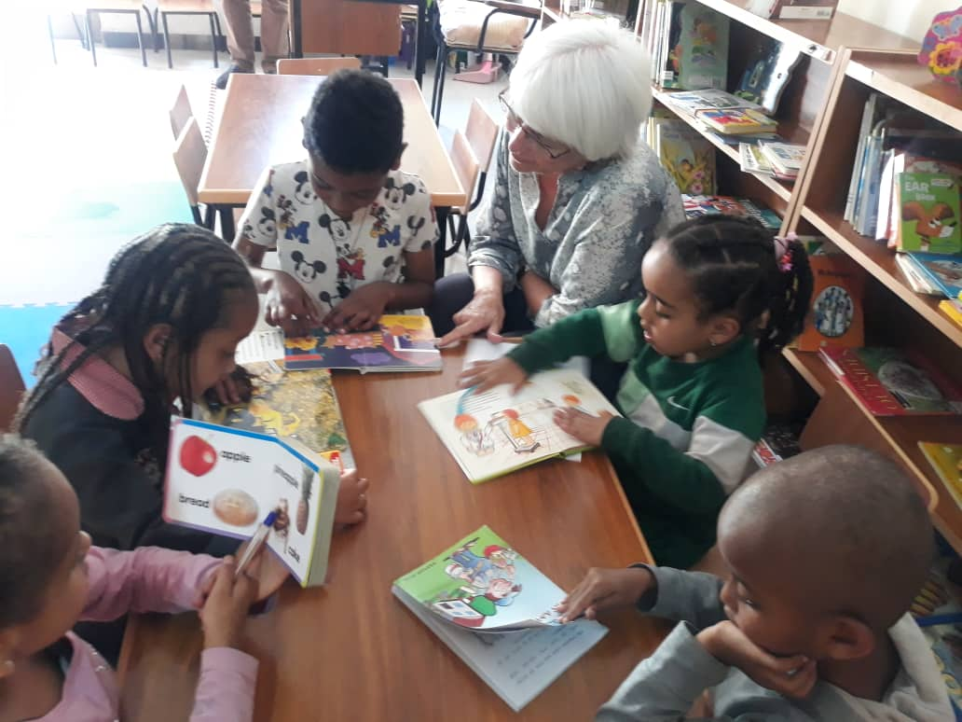
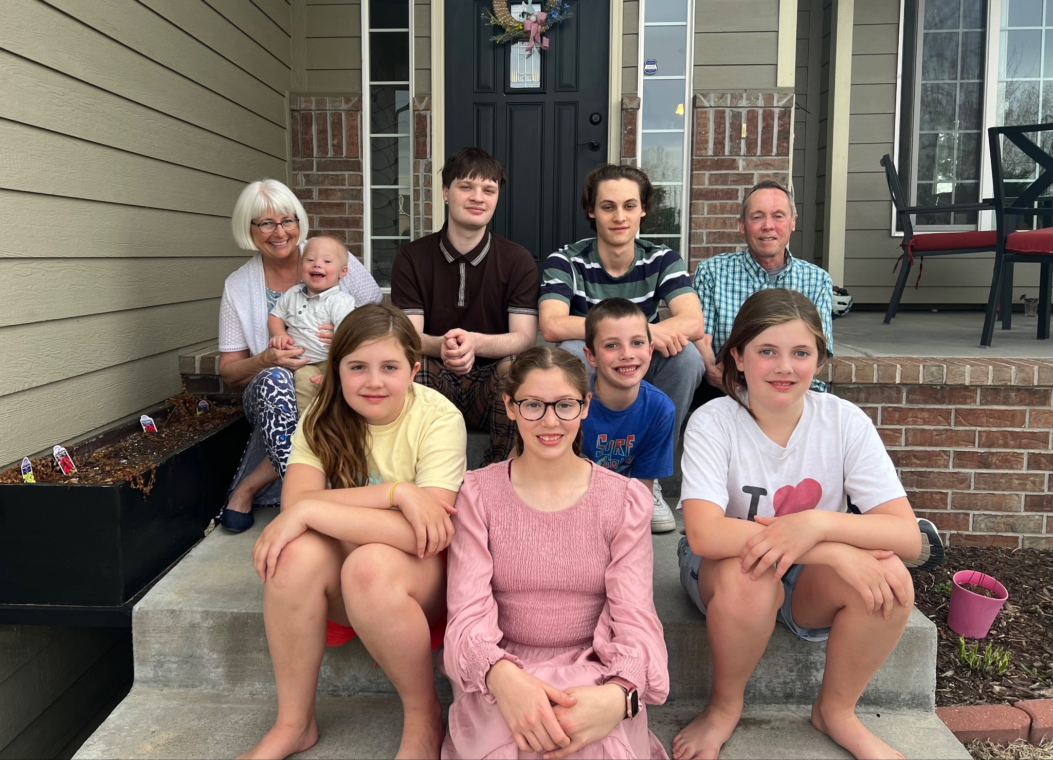
Dr. Laurie Curtis, Program Manager
Early Literacy/ Dyslexia Team (CSAS)
B.A Degree in Elementary Education
University of Northern Colorado
MS Degree in Elementary Education/ Reading
State University of New York
PhD in Curriculum & Instruction
Kansas State University
Elementary Teacher (15 years)
Kansas State University Faculty/ Literacy Methods
Director, Reading Specialist Program (MS/ PHD) (14 years)
International Literacy Consultant, Ethiopia Reads
KSDE, December 2022- Present

Slide 3
Early Literacy/ Dyslexia Team
Field Educators (FEs)
Teacher Leader Consultants (TLCs)
Sam Cool
Mary Larkin
Katie Orr
Deanna Frost
Taylor Fegan
Hailey Hawkinson
Melissa Brunner
Jeri Powers
Amy Bybee
Casey Peine

Slide 4
This session’s objectives:
Acknowledge and discuss terms such as dyslexia, the science of reading, structured literacy…recognizing how they inform practice.
Identify useful resources that can help students persevere in the difficult work of learning to read and reading to learn.
Evaluate your role and responsibility in making data-based decisions while working with students who find reading and spelling difficult.
Learn about the current initiatives and expectations regarding Dyslexia in the state of Kansas

Slide 5
The Science of Reading “There is only a problem if we stop asking questions about what we are doing.” Mark Seidenberg

Slide 6
What is the science of reading?
It isn’t a curriculum
It isn’t a program
It isn’t “phonics”
It is a body of multidisciplinary knowledge that informs what we know about how people learn to read and how best to teach people to read.

Slide 7
Dyslexia

Slide 8
Dyslexia is “a specific learning disability that is neurobiological in origin. It is characterized by difficulties with accurate and/or fluent word recognition and by poor spelling and decoding abilities. These difficulties typically result from a deficit in the phonological component of language that is often unexpected in relation to other cognitive abilities and the provision of effective classroom instruction. Secondary consequences may include problems in reading comprehension and reduced reading experience that can impede growth of vocabulary and background knowledge.”

Slide 9
Boston College Reading Lab

Slide 10
Myths related to dyslexia
Students with dyslexia read backwards or words jump around on a page.
There are more boys with dyslexia than girls
If you have dyslexia, you should qualify for special education services
You will grow out of dyslexia
Students with dyslexia are very artistic and creative
Notes:
There is not a reading area in the brain, although there is a language area- we have caused multiple areas of the brain to cooperate to gain the skill of reading s symbol system.

Slide 11
What might you see/ notice?
Avoidance behaviors when reading / writing
Errors when reading high frequency words, or words in lists
Lack of fluent reading- lack of expression (prosody)
Slow reading with low comprehension
Difficulty in pronunciation
Reliance on “safe” words, such as “stuff” or “things”- lack of vocabulary
Heavy reliance on context and pictures when reading or solving problems

Slide 12
Ways to help…
Look and listen for characteristics of dyslexia, use tiered support
Provide exemplary instruction
Clarify instructions
Reduce “timed” work
Do not ask students to read in front of others- it often coexists with anxiety and/ or depression
Provide support for executive function issues

Slide 13
Theory?
The Simple View of Reading…Scarborough’s Reading Rope

Slide 14
Simple View of Reading
Reading Comprehension
Word
Recognition
Language Comprehension
X
=
Notes:
Oral language is important. Being exposed to conversation, rich language and books before you started school set you on the path to being a reader.

Slide 15
One Model for Guiding our Practice
Notes:
When there is a part or multiple parts of this rope that are not working- skilled reading becomes very difficult to attain. When those difficulties are primarily related to the bottom (blue) portions of this representation, we might find students have characteristics of a disorder called dyslexia. It involves difficulty in processing speech sounds and the code used in writing down those words and reading those words.

Slide 16
Structured Literacy
Not just the “what” but the “how”

Slide 17
There is a model for teaching literacy that is beneficial for all students and critical for those who struggle reading proficiently.
It is called:
Structured Literacy
It has been adopted by the Kansas State Board of Education as the model for instruction in our Kansas schools.
It is NOT just phonics. It is not a phonics curriculum added to a balanced literacy program. It is relevant K-12.
It addresses the art and science of teaching- how you deliver instruction matters. Pedagogy is powerful!

Slide 18
Is it “the big five”? Why not balanced literacy? ”There are a lot of ways to teach kids to read” (teaching-vs-learning) Why not guided reading? What’s wrong with leveled books? Why not guided reading with an extra dose of phonics?

Slide 19
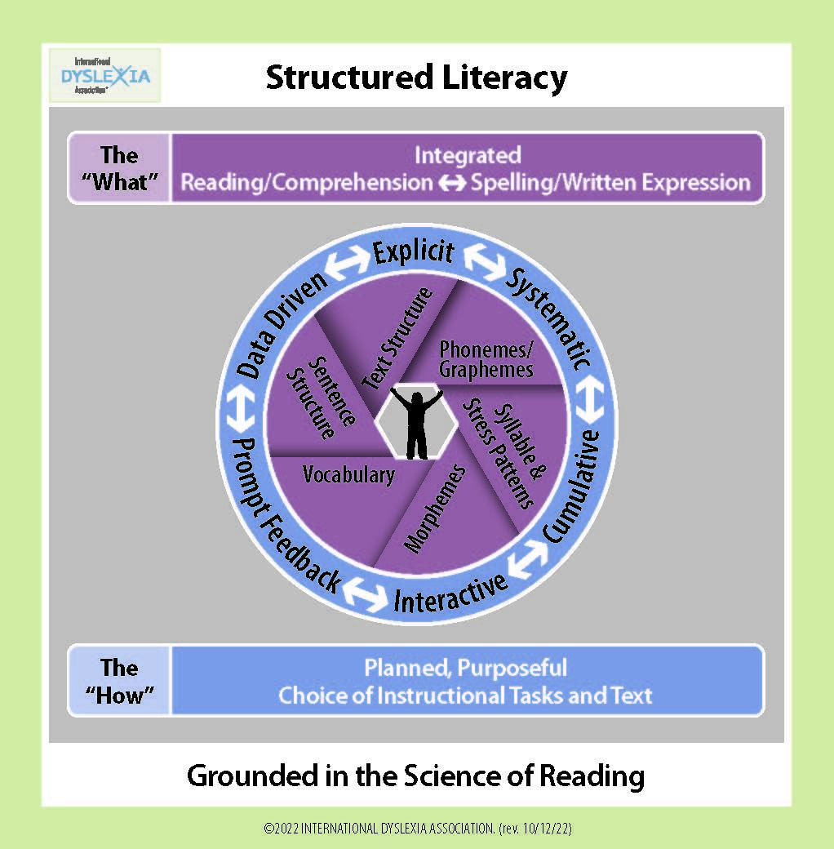

Slide 21
Helpful hints for lesson planning?
State clear objectives
Explicit and systematic instruction- there should be NO question what they are learning and why it is important
Teacher modeling, guided practice, independent practice- gradual release of responsibility
Use multiple ways of representing language
Spaced review
Lesson closure

Slide 22
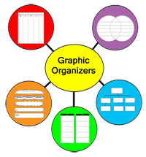
Who is doing the thinking when you “assign” a graphic organizer? How can you teach, rather than just give instructions?

Slide 23
A moth has two sets of wings. It folds the wings down over its body like a roof when it rests. The moth has feathery antennae and spins a fuzzy cocoon. It has a gray or white color and usually flies at night. The moth goes through four stages of development: egg, caterpillar, pupa, and adult.
A butterfly goes through four stages of development (egg, caterpillar, pupa, and adult) and has two sets of wings. Its antennae are long and thick with knobs at the ends. When a butterfly rests, its wings are straight up like outstretched hands. A butterfly is brightly colored and flies during the day.
(Kiewra & DuBois, 1998)

Slide 24
KSDE Requirements and Expectations
Screening, Professional Learning, Reporting

Slide 25
PK-12 Systems Currently
Training
KESA Expectations
Assure that teachers new to the profession complete the required KSDE Dyslexia modules. These are under revision for completion by January, 2024: K-6/ Administrators & Middle-Secondary/ Administrators
All systems provide annual training in structured literacy.
Use structured literacy as a model of instruction
Have MTSS to provide strong Tier 1 and tier 2 and 3 interventions- data-driven
Following the Dyslexia Handbook- Screen as directed by the State Board of Education as recommended by the Legislative Task Force on Dyslexia
Notes:
Hold schools accountable through compliance

Slide 26
Every Child Can Read Act (July 1, 2023)
3rd grade marks a pivotal time at which students must attain basic literacy proficiency
Our approach is based on the Science of Reading
Refers to the Kansas Dyslexia Handbook
Instruction should be around “five components” of NRP
Literacy measured by state assessments, screeners/ assessments
Tiered interventions match literacy needs
Additional contact hours provided students as needed
Parents are informed of the: legislation, assessments, interventions and how things are monitored for effectiveness

Slide 27
K-8 Students
All K-8 students are screened 3 times per year
Valid, reliable, nationally normed screener
Allows for subtests:
Letter naming fluency
Letter/ sound fluency
Phoneme segmentation fluency
Nonsense word fluency
Oral reading fluency
Comprehension measure (6-8), followed by ORF if risk identified
Systems follow schedule recommendation from technical manual
Approved screeners: Acadience, AimsWeb Plus, DIBELS, Early Reading/Star, EasyCBM, FastBridge, iReady- and KSDE Alternative Screener

Slide 28
Required Reporting on KIDS: K-8
Spring scores uploaded to KIDS
Kindergarten: phoneme segmentation
1st Grade: letter word sound fluency
2nd Grade: Oral reading fluency (both rate and accuracy)
3rd Grade: Oral reading fluency (both rate and accuracy)
8th Grade: Reading comprehension
At or above or below benchmark (some or high risk)
ORF 4 options: both rate and accuracy above; rate and accuracy below; rate above, accuracy below; accuracy above, rate low

Slide 29
Secondary Students
All students are assessed in the fall of their 9th grade year
valid, reliable, nationally normed comprehension screener
Provides building baseline- check Tier 1
identify students who are identified at some or high risk for reading difficulty for further diagnostic
There are options to validate student’s scores to exit screening or to remain in intervention and screening protocols
How do teachers help students navigate complex content-area texts?

Slide 30
Purpose of the KS Alternate Early Literacy Screener
IDEA
Sec. 300.160 Participation in assessments
(a) General. A State must ensure that all children with disabilities are included in all general State and districtwide assessment programs, including assessments described under section 1111 of the ESEA, 20 U.S.C. 6311, with appropriate accommodations and alternate assessments, if necessary, as indicated in their respective IEPs.
Notes:
IDEA requires a state to ensure that all children with disabilities are included in all general State and districtwide assessment programs. Since Kansas has a reporting requirement for grades Kdg-3, we needed to develop or obtain an alternate screener to meet the needs of those students with the most significant cognitive disabilities who could not participate in the general screening

Slide 31
What is the Kansas Alternate Early Literacy Screener?
The Kansas Alternate Early Literacy Screener is a simple rubric that assesses students’ early literacy skills as they relate to skill domains within English Language Arts (print concepts, phonological awareness, phonics and word recognition, fluency and comprehension).
The rubric is meant to be completed for each student with a Significant Cognitive Disability (grades K-3) by their teacher, based on the student’s performance on Individualized Education Program (IEP) goals and every day early literacy instruction within the classroom.

Slide 32
Additional Updates

Slide 33
K-12 ELA Standards Revised

Slide 34
LETRS
Language Essentials for Teachers or Reading and Spelling
Expansion of LETRS training
With or without a defined district cohort, teachers can take this training, funded for (about) another year.
LETRS for Administrators

Slide 35
Upcoming Professional Learning
Text-based PD A Fresh Look at Phonics, 6 weekly sessions (Fall 23)
Structured Literacy Intervention Text-Based PD, Sept 2023- Feb. 2024
Literacy Lifeline- Virtual Office hours Thursdays 3:30-5:00 (after Labor Day)
See the KSDE Dyslexia Page for pre-recorded professional learning sessions
Notes:
How I can help- Professional Learning

Slide 36
Early Literacy/ Dyslexia Resources
KSDE Early Literacy/ Dyslexia Page
KSDE Early Literacy/ Dyslexia Information
KSDE Early Literacy/ Dyslexia Newsletter
International Dyslexia Association Fact Sheets
What Every Teacher Should Know
The Reading League Resources

Slide 37
This session’s objectives:
Acknowledge and discuss terms such as dyslexia, the science of reading, structured literacy…recognizing how they inform practice.
Identify useful resources that can help students persevere in the difficult work of learning to read and reading to learn.
Evaluate your role and responsibility in making data-based decisions while working with students who find reading and spelling difficult.
Learn about the current initiatives and expectations regarding Dyslexia in the state of Kansas

Slide 38
Questions?

Slide 39
Contact Information
Dr. Laurie Curtis Early Literacy/Dyslexia Program Manager Career, Standards and Assessment Services (785) 296-2749 lcurtis@ksde.org

